Slide 1


OMIS 661 Project(Group-D)
Gouri Patil (Z1931431)
Divya Tirumala (Z1907811)

Slide 2
Agenda
Data Cleaning
Data Modeling
Dashboard
Findings & Conclusion
Data Analysis & Visualization
Executive Summary
Data Overview

Slide 3
Executive Summary
Airbnb is a company operating an online marketplace for short- and long-term homestays and experiences.
Objective of the project is to analyze and visualize the listings of Chicago.
Performance of listing prices.
Understand the pattern of bookings and availability.
Behavior pattern of hosts and guests.
Review and feedback analysis.

Slide 4
Data Overview
Sourced from insideairbnb.com
http://insideairbnb.com/get-the-data/
Unit of Analysis : listings in Airbnb Chicago
7748 listings
Listings, Property Details, Review Details, Availability, Review Scores
Snowflake Schema with 1 measure and 5 dimensions

Slide 5
Data Cleaning
Selected the required fields and loaded data from excel into Power BI.
Removed "N/A" and blank rows.
Replaced some important blank column data with null values.
Removed rows that had junk data in the comments section of customer data.
Filtered records based on the required dates.
Split and create new columns. Eg: City, State.
Irrelevant columns were removed.
Renamed column names
Created some custom columns like for date : day, month and year.

Slide 6
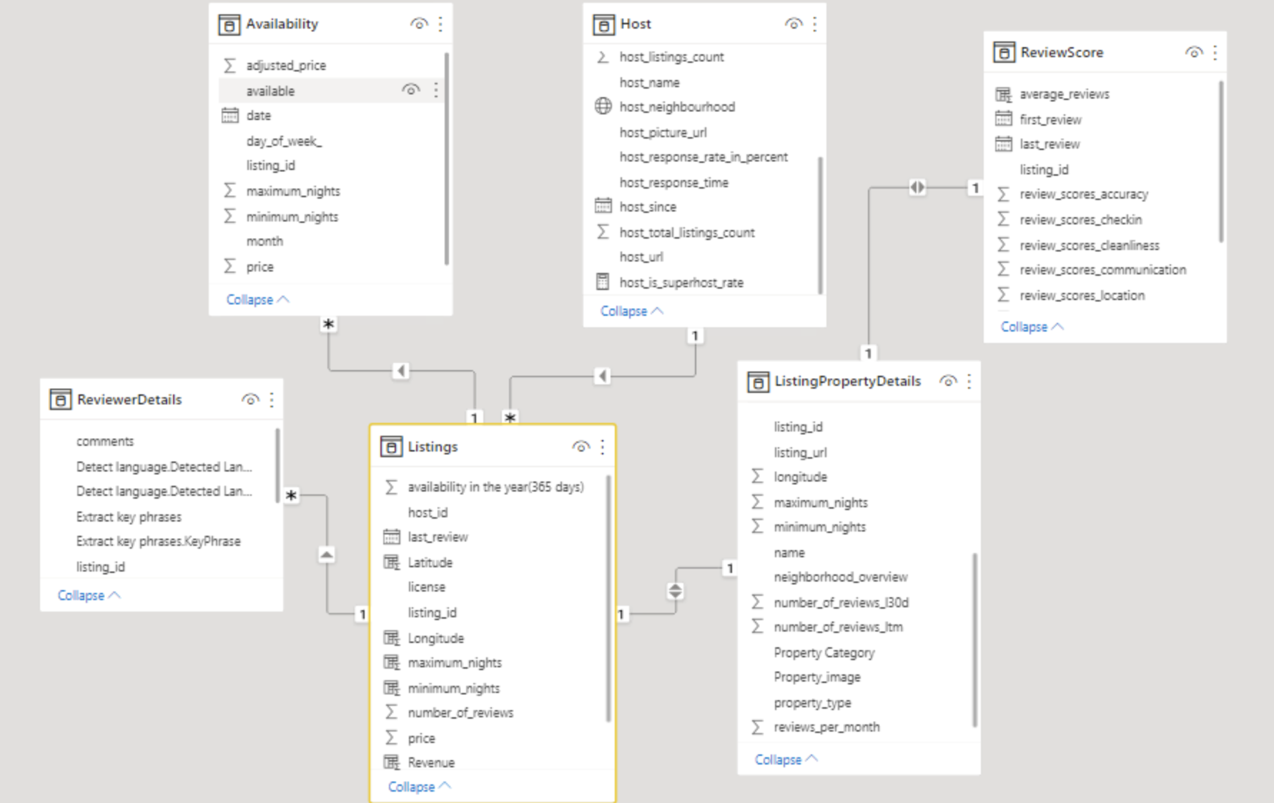
Data Modeling

Slide 7
Data Analysis & Visualization
Price Analysis
We analyzed the pricing details of each neighborhood based on property category, number of bedrooms, property type, room type and the amenities provided by the listings.

Slide 8
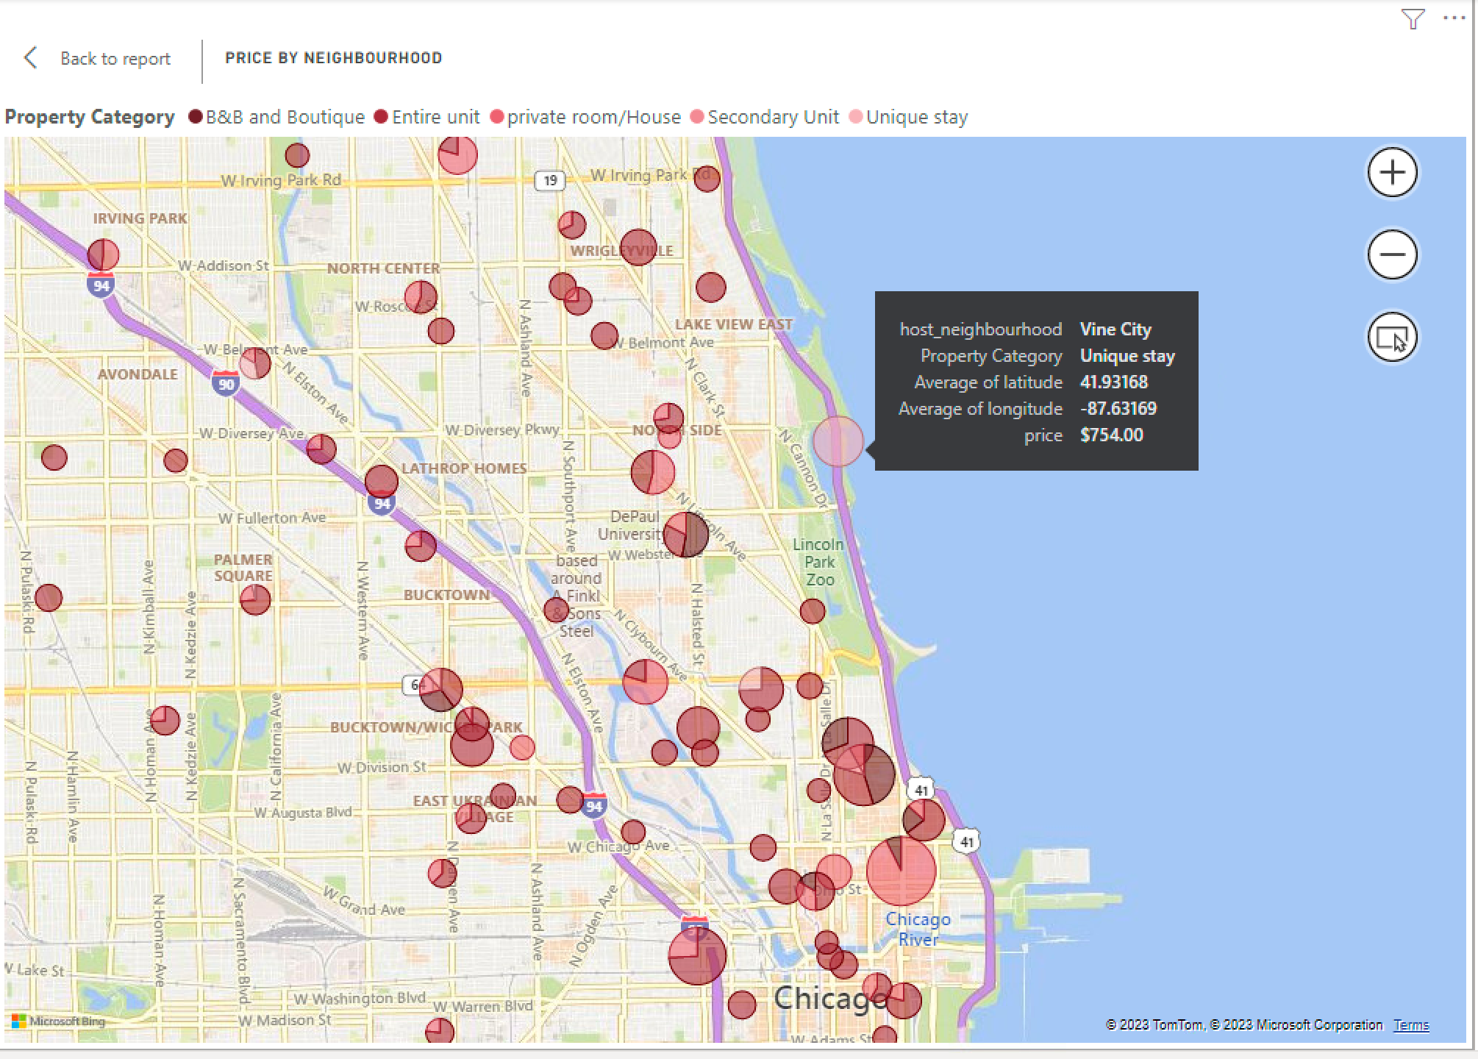
Data Analysis & Visualization

Slide 9
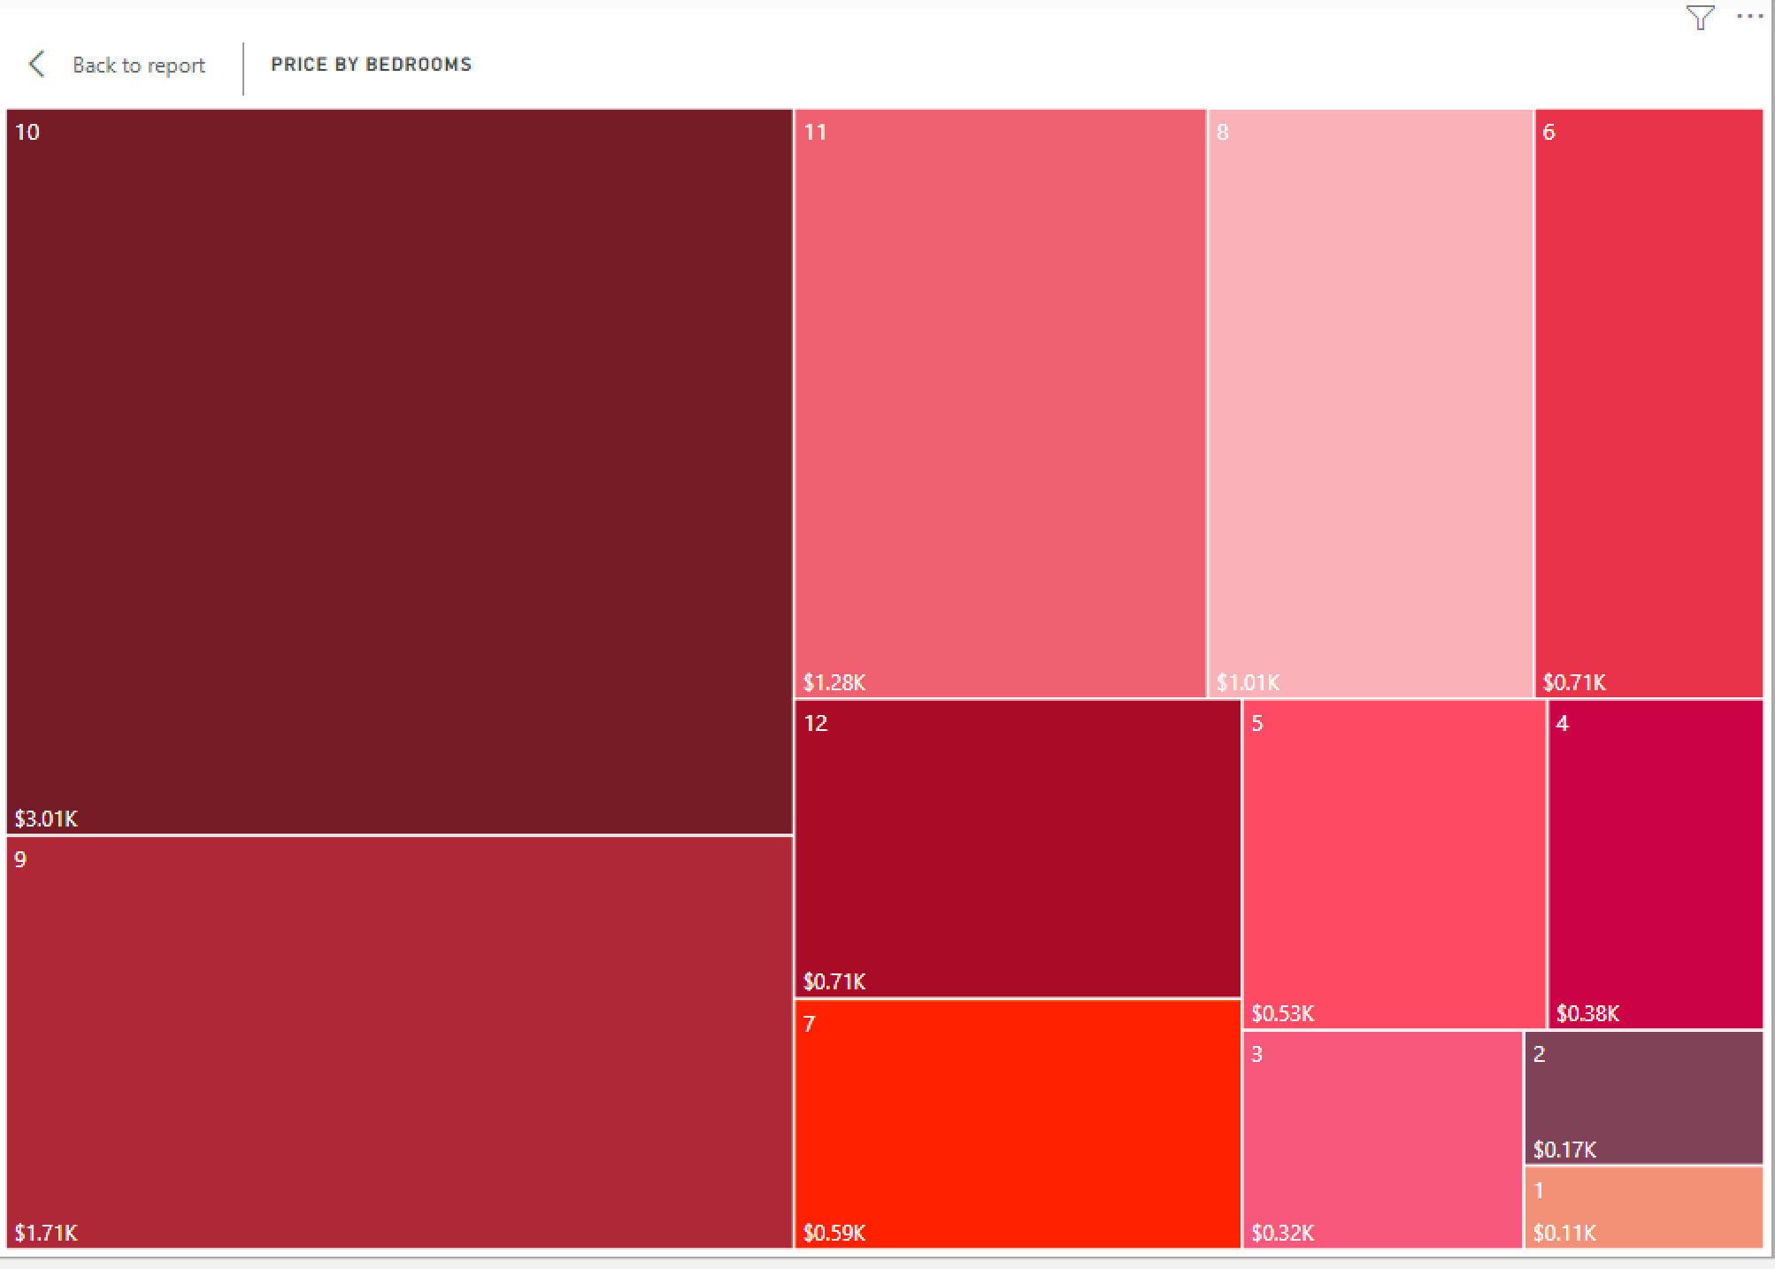
Data Analysis & Visualization

Slide 10
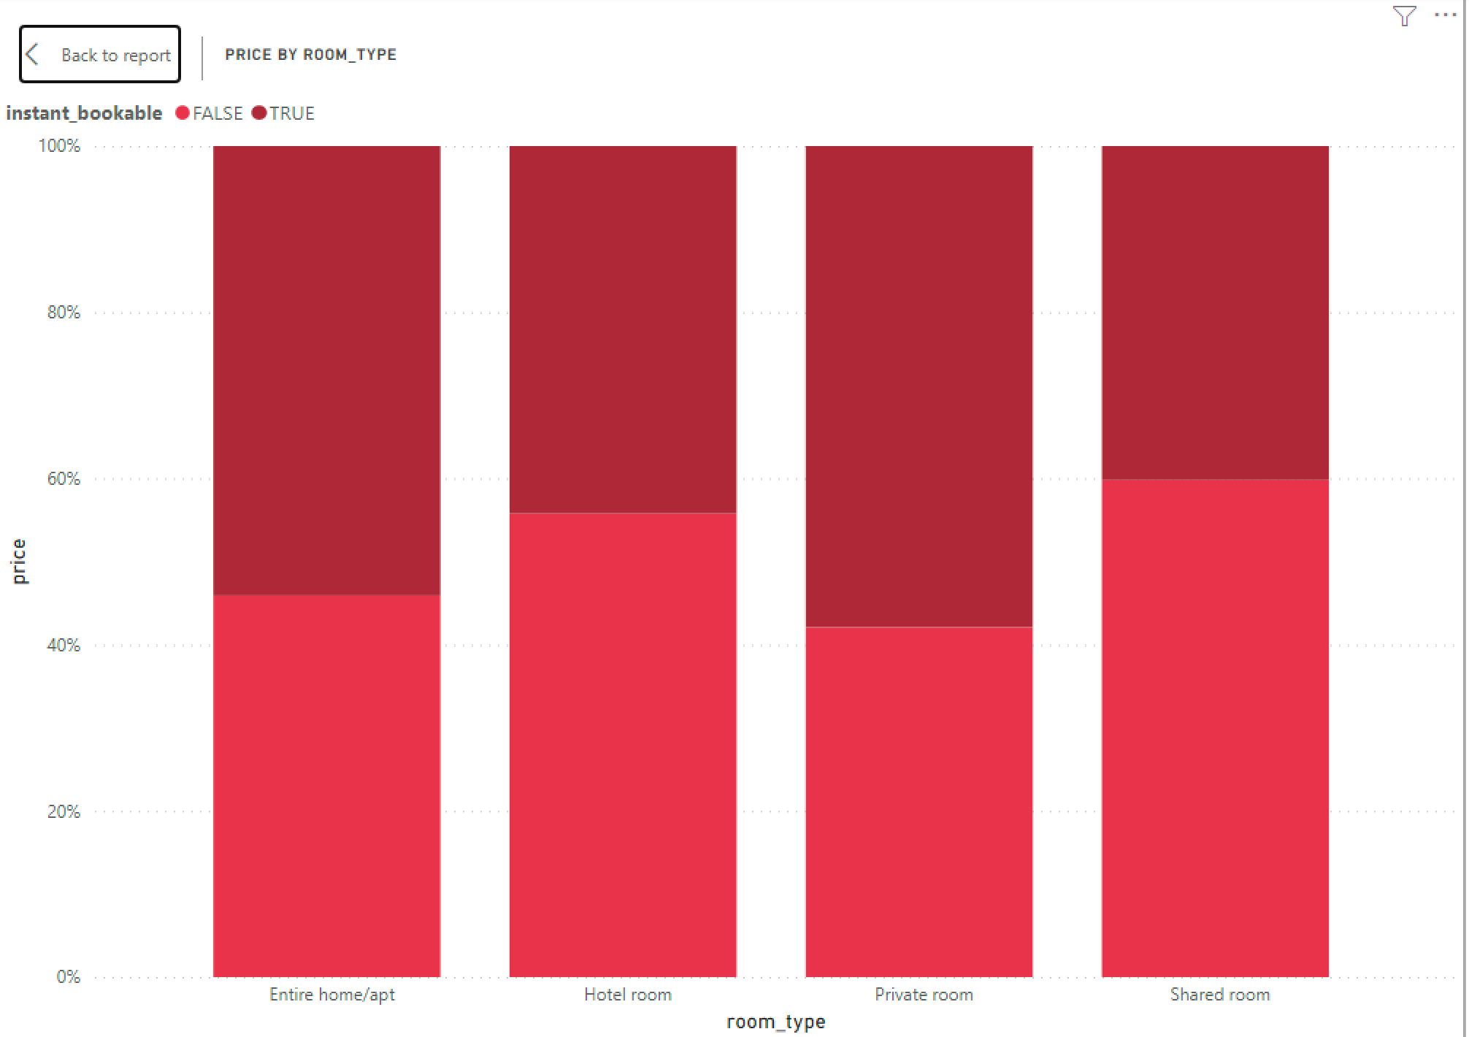
Data Analysis & Visualization

Slide 11
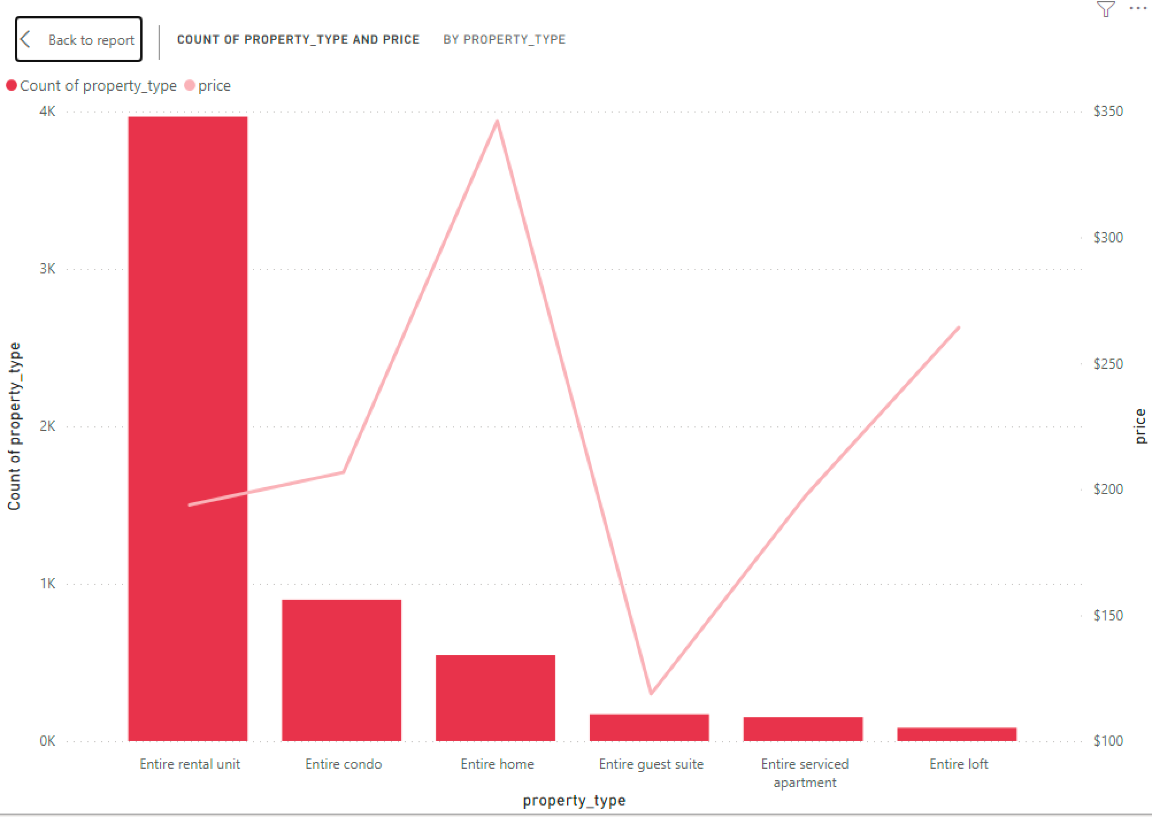
Data Analysis & Visualization

Slide 12
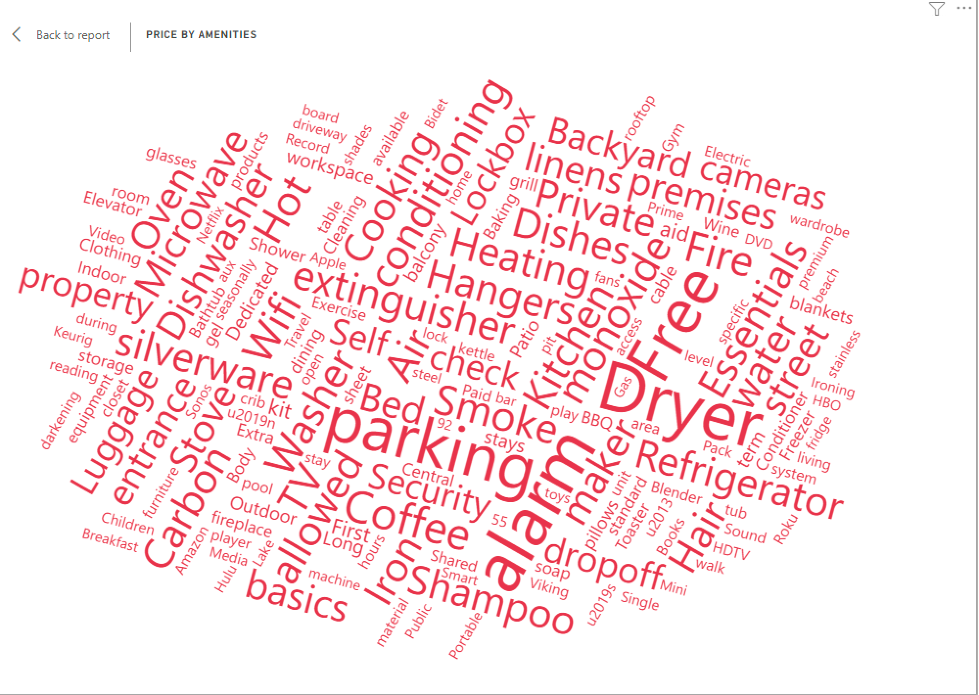
Data Analysis & Visualization

Slide 13
Data Analysis & Visualization
Property and Listing Analysis
We created visualization to see the property prices based on the reviews count ,and listing by property type, room type and over the months

Slide 14
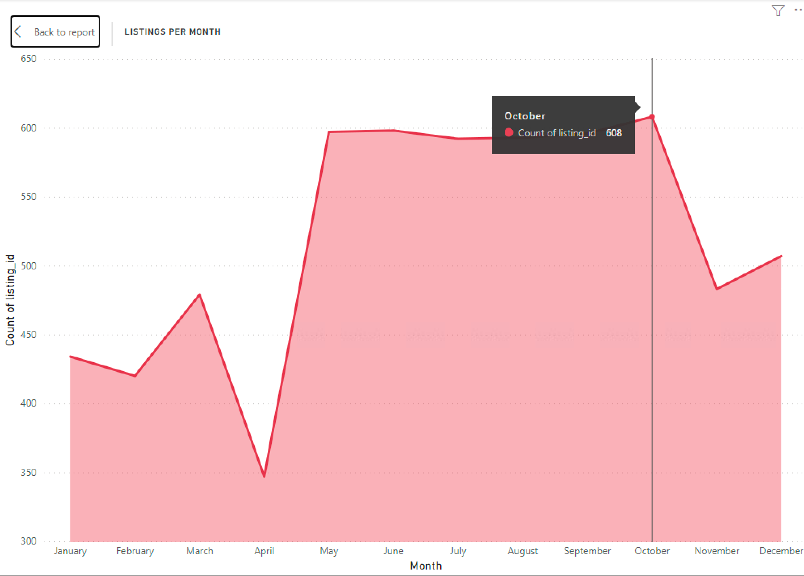
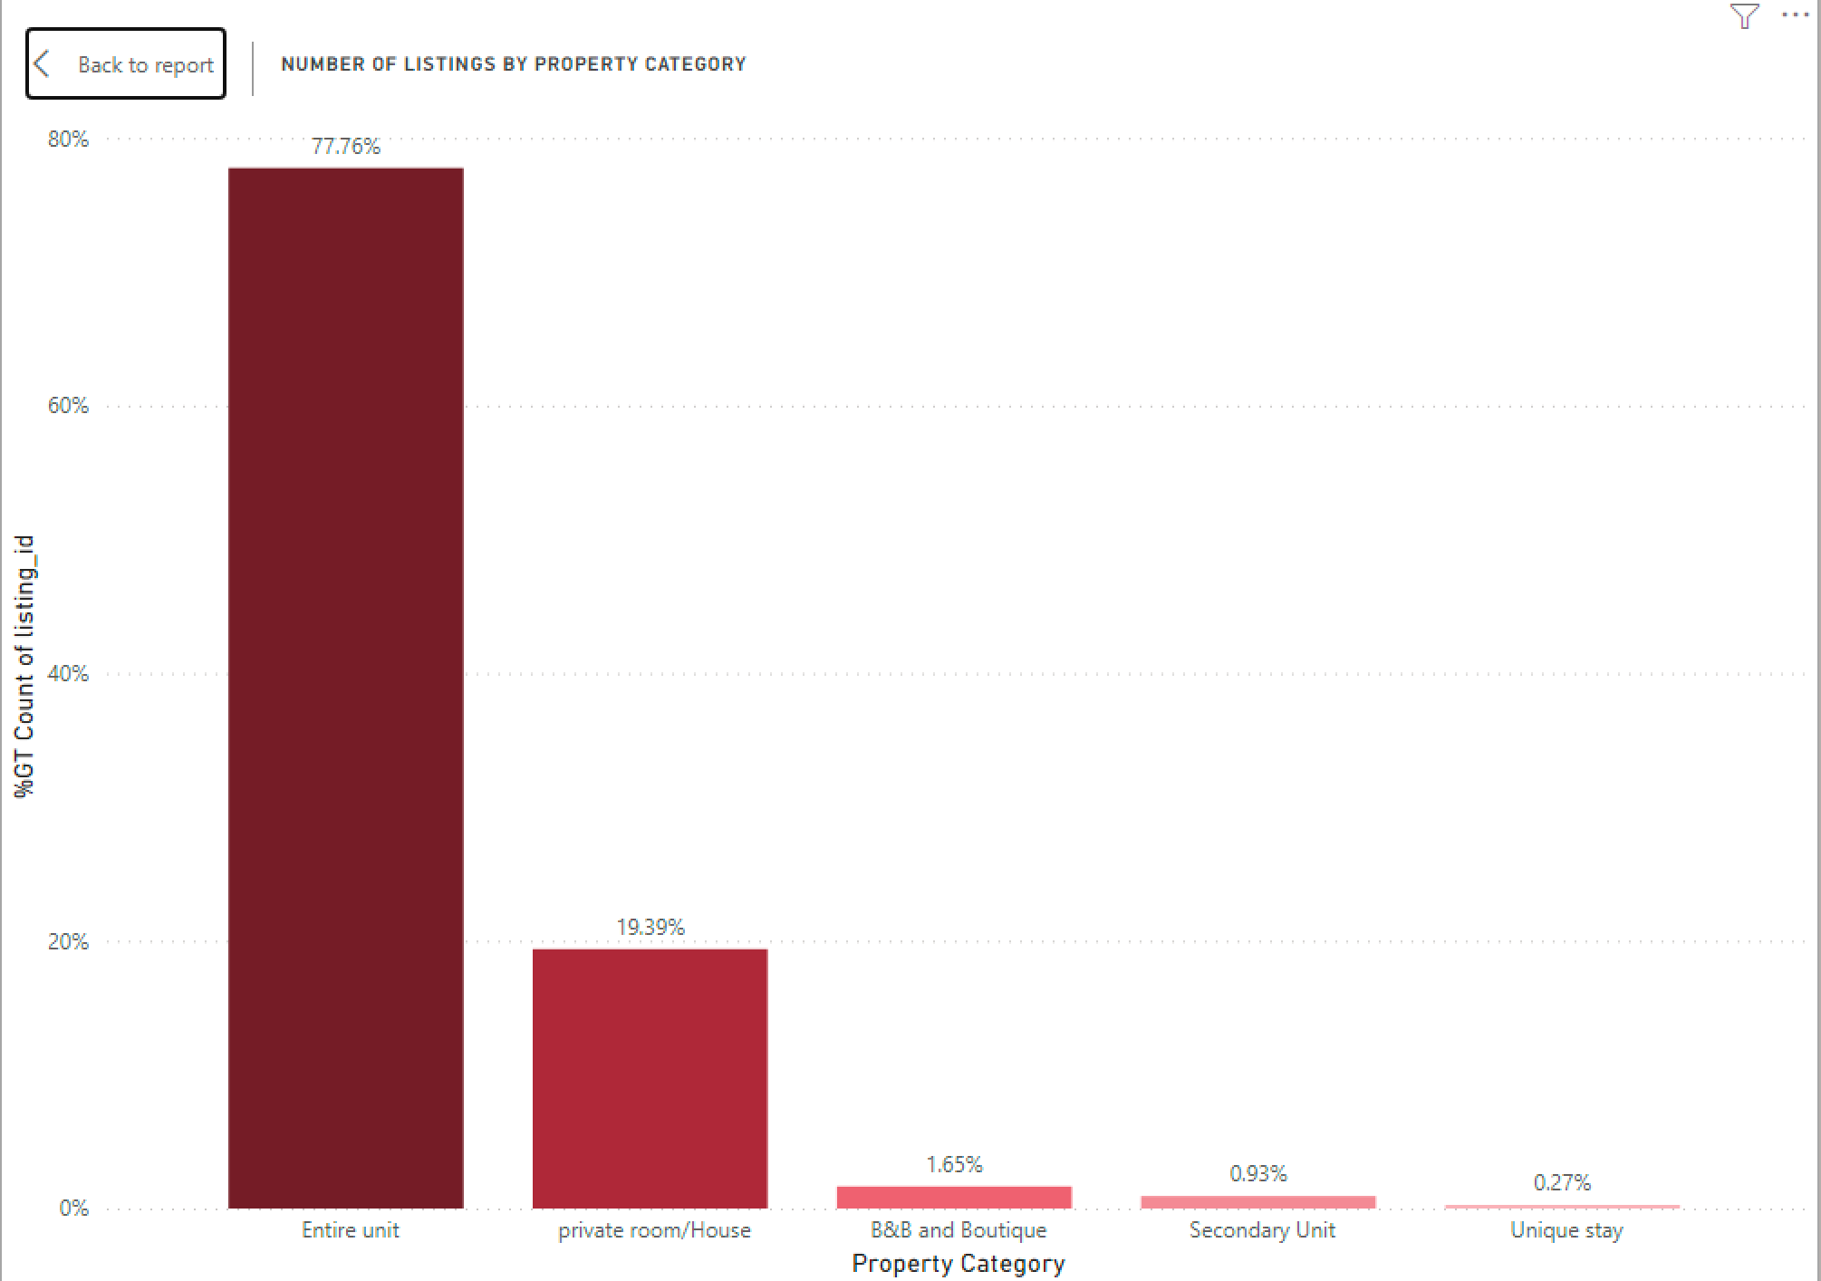
Data Analysis & Visualization

Slide 15
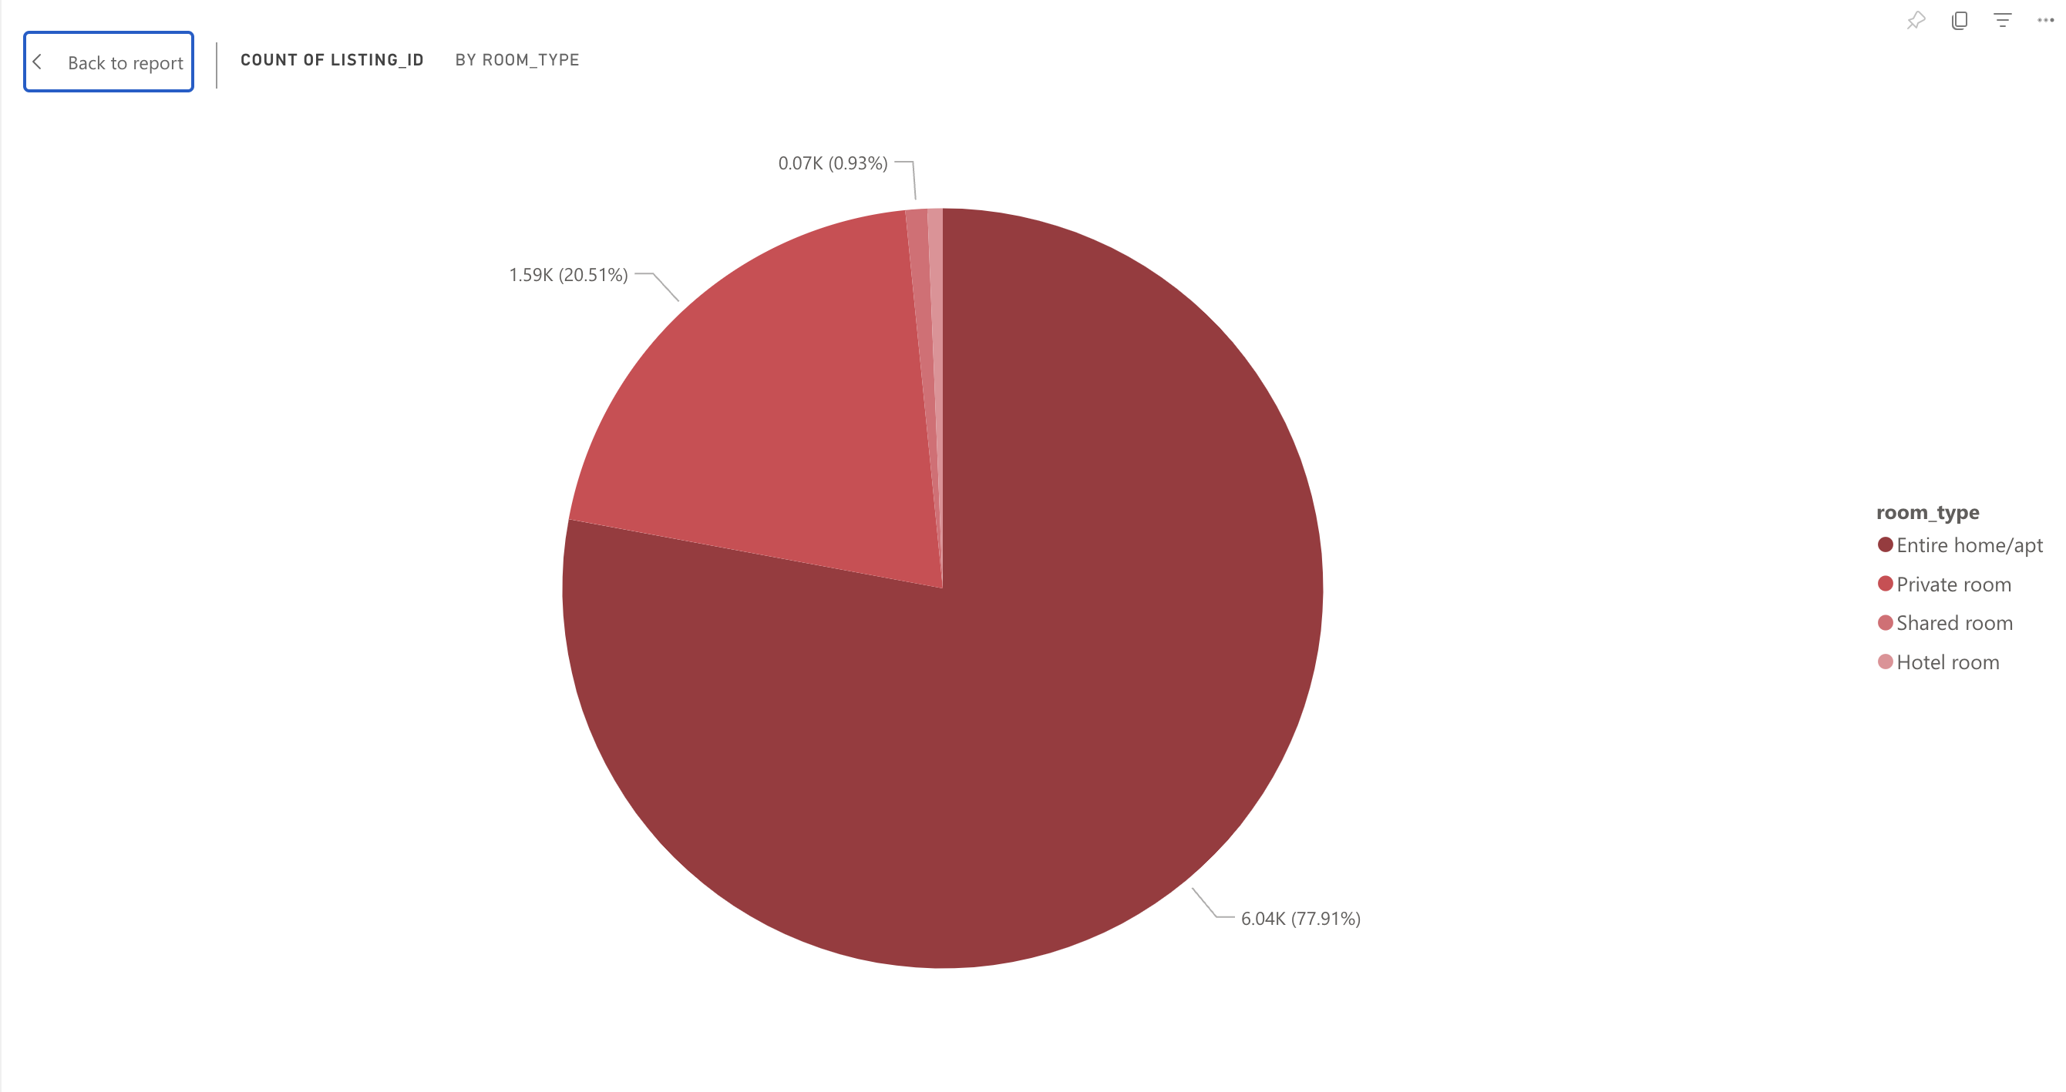
Data Analysis & Visualization

Slide 16
Data Analysis & Visualization
Availability Analysis
We wanted to know the Key influencers effecting the availability along with each month's availability and total bookings.

Slide 17
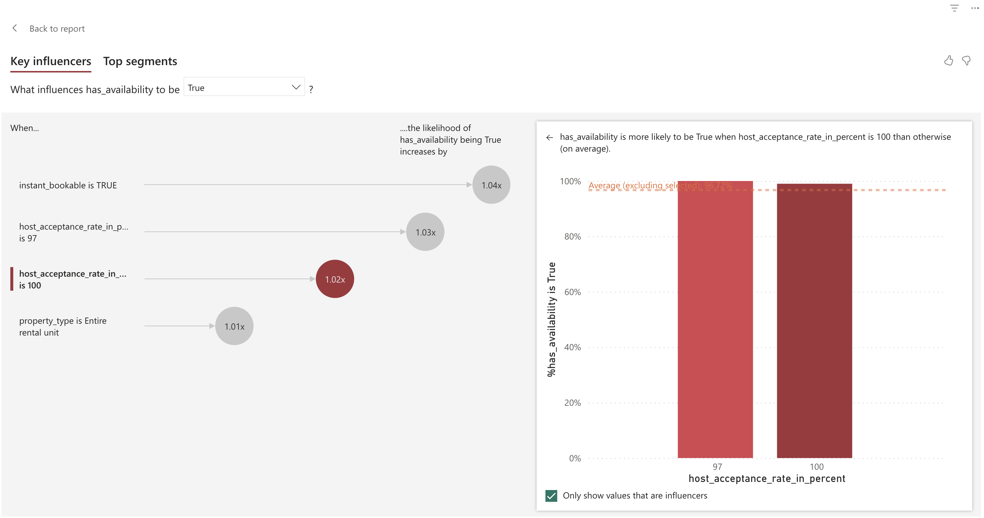
Data Analysis & Visualization

Slide 18
Data Analysis & Visualization
Host Analysis
Top 10 hosts with highest listings and number of reviews for each host

Slide 19
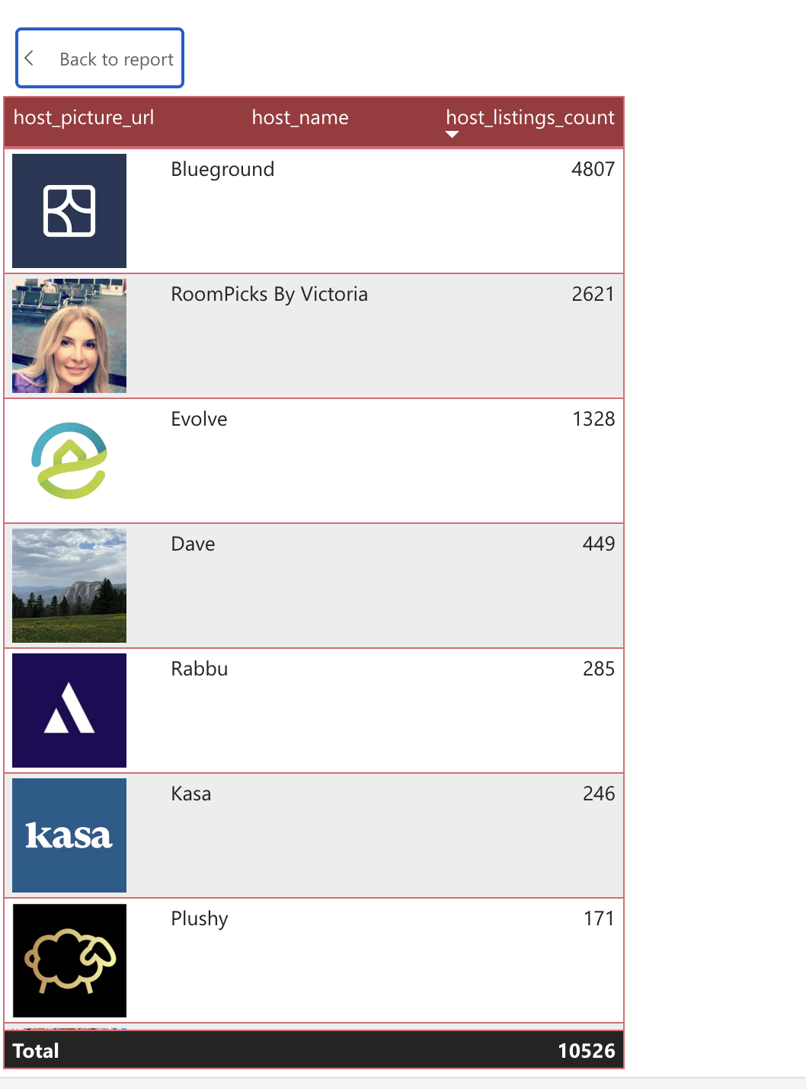
Data Analysis & Visualization

Slide 20
Data Analysis & Visualization
Review Analysis
We did sentiment analysis based the customer reviews and we also visualized the top 10 locations based on review score.

Slide 21
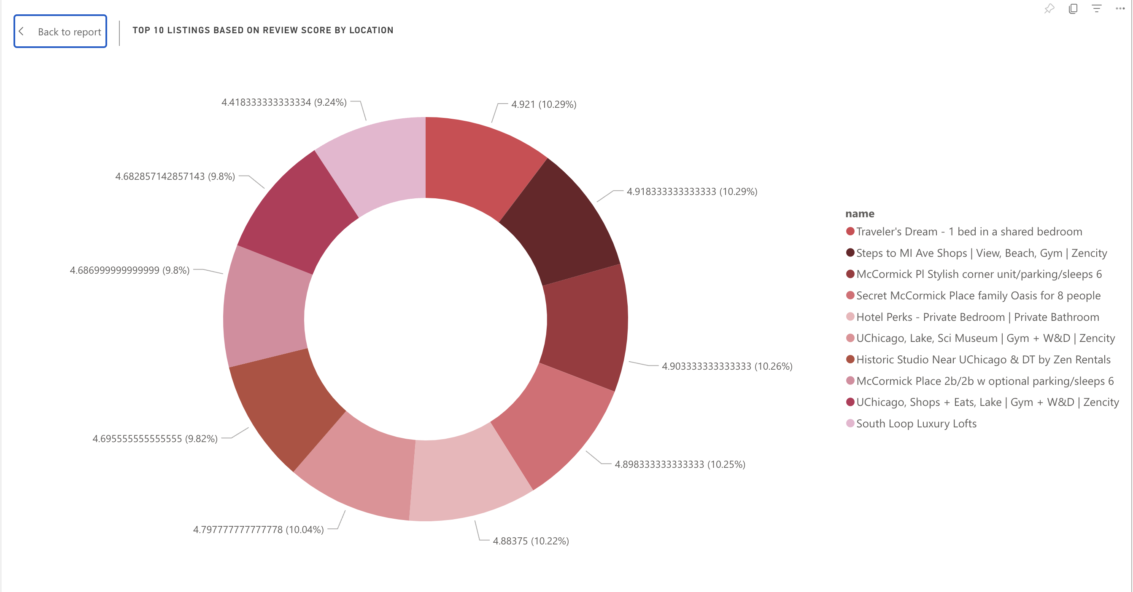
Data Analysis & Visualization

Slide 22

Dashboard
https://app.powerbi.com/groups/me/dashboards/0acbcc0b-98a3-485c-935c-ce8dd3b310da

Slide 23
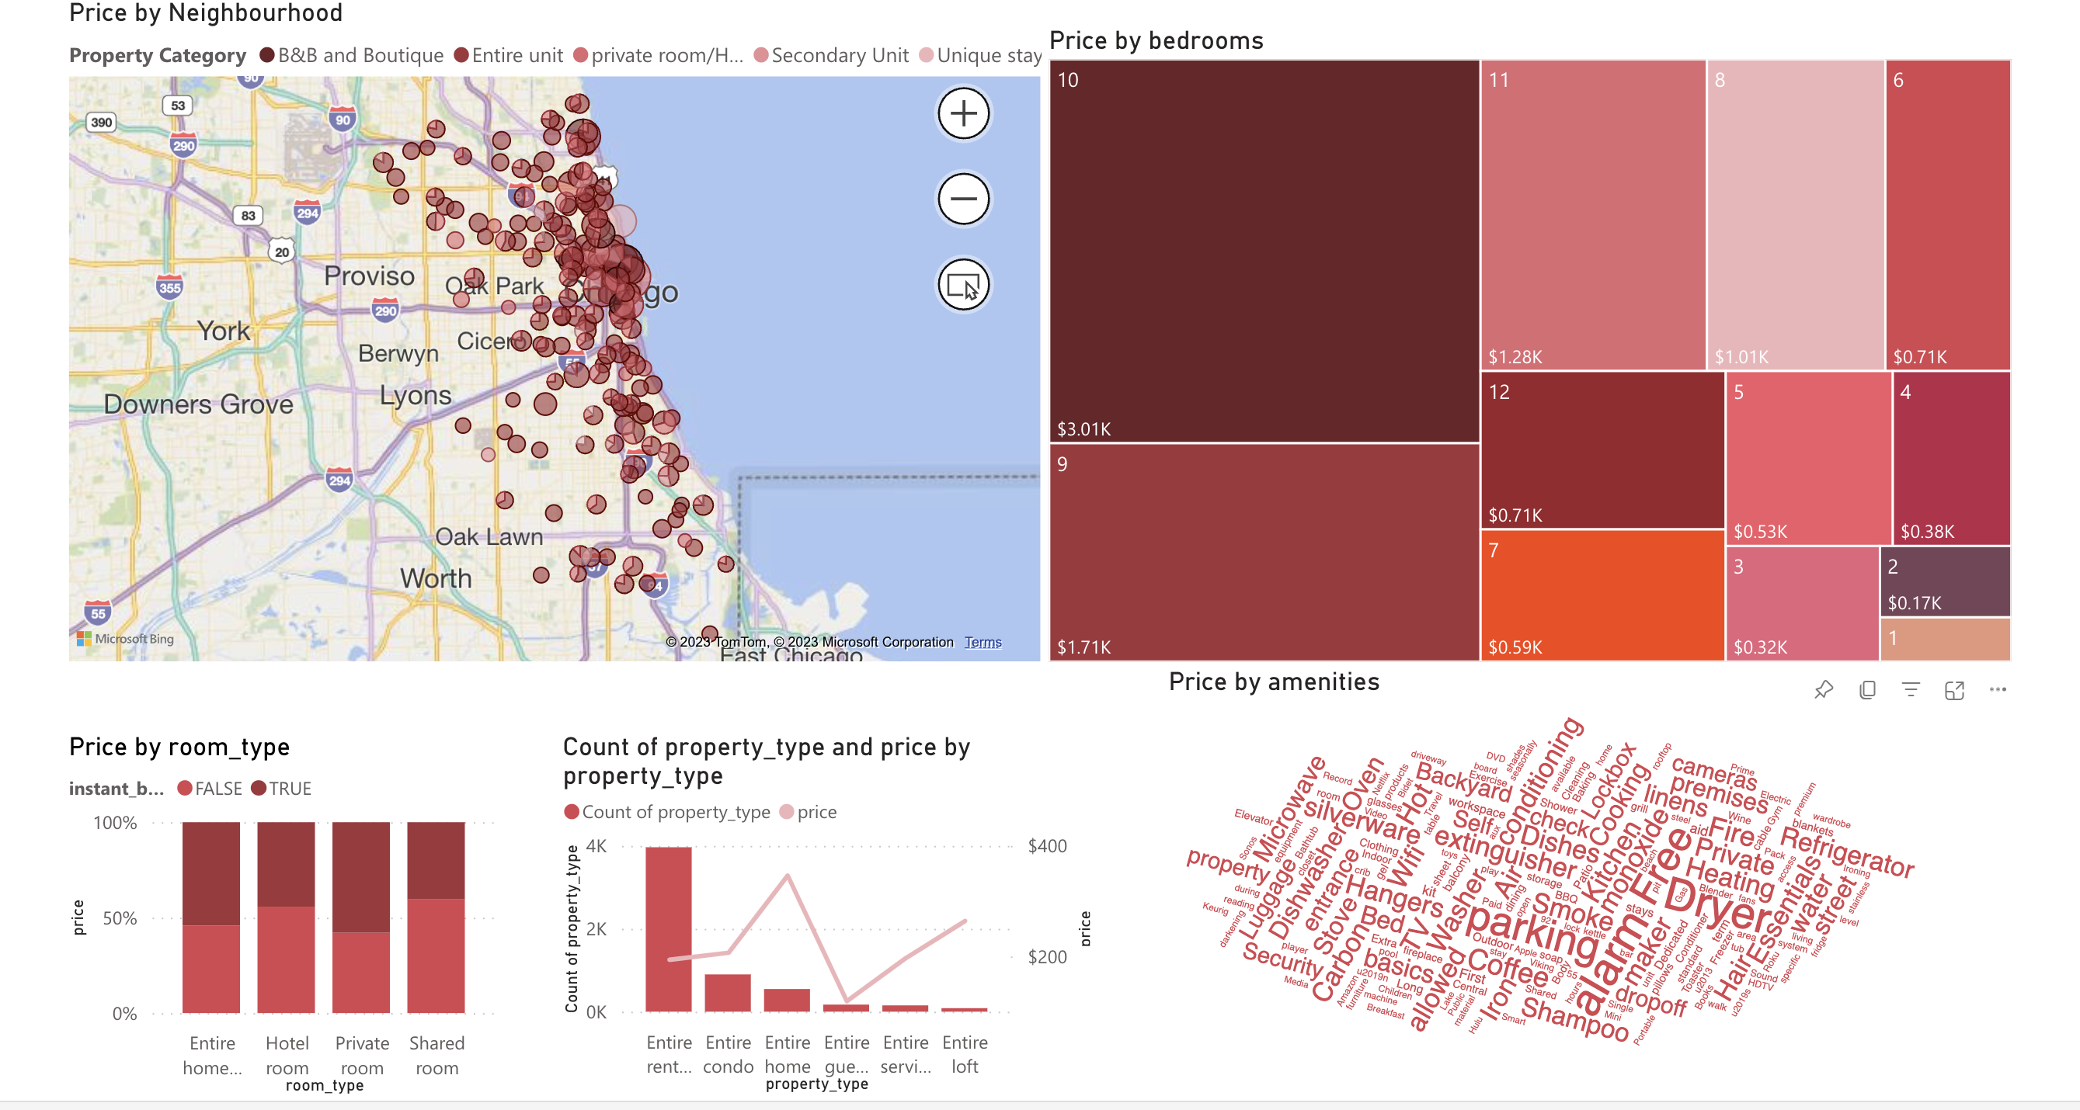
Price Analysis

Slide 24
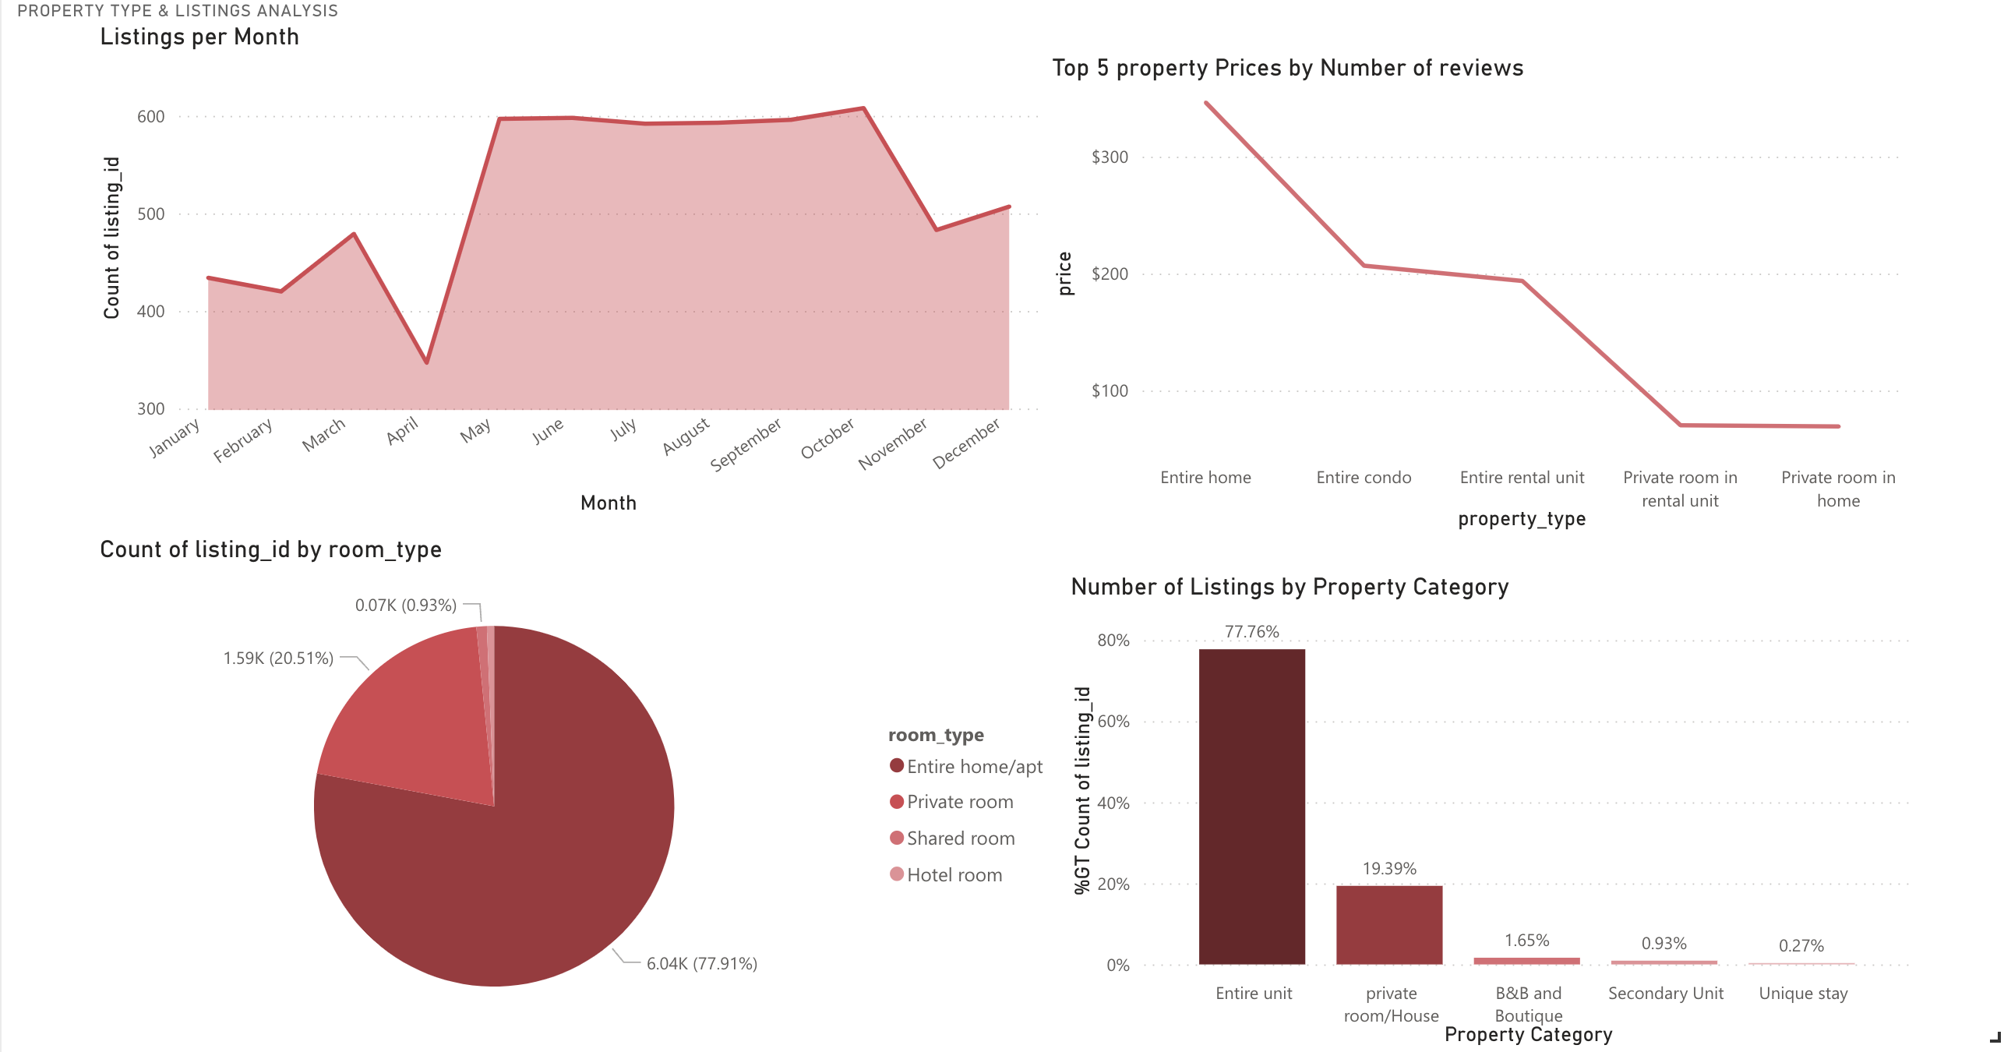
Property and Listing Analysis

Slide 25
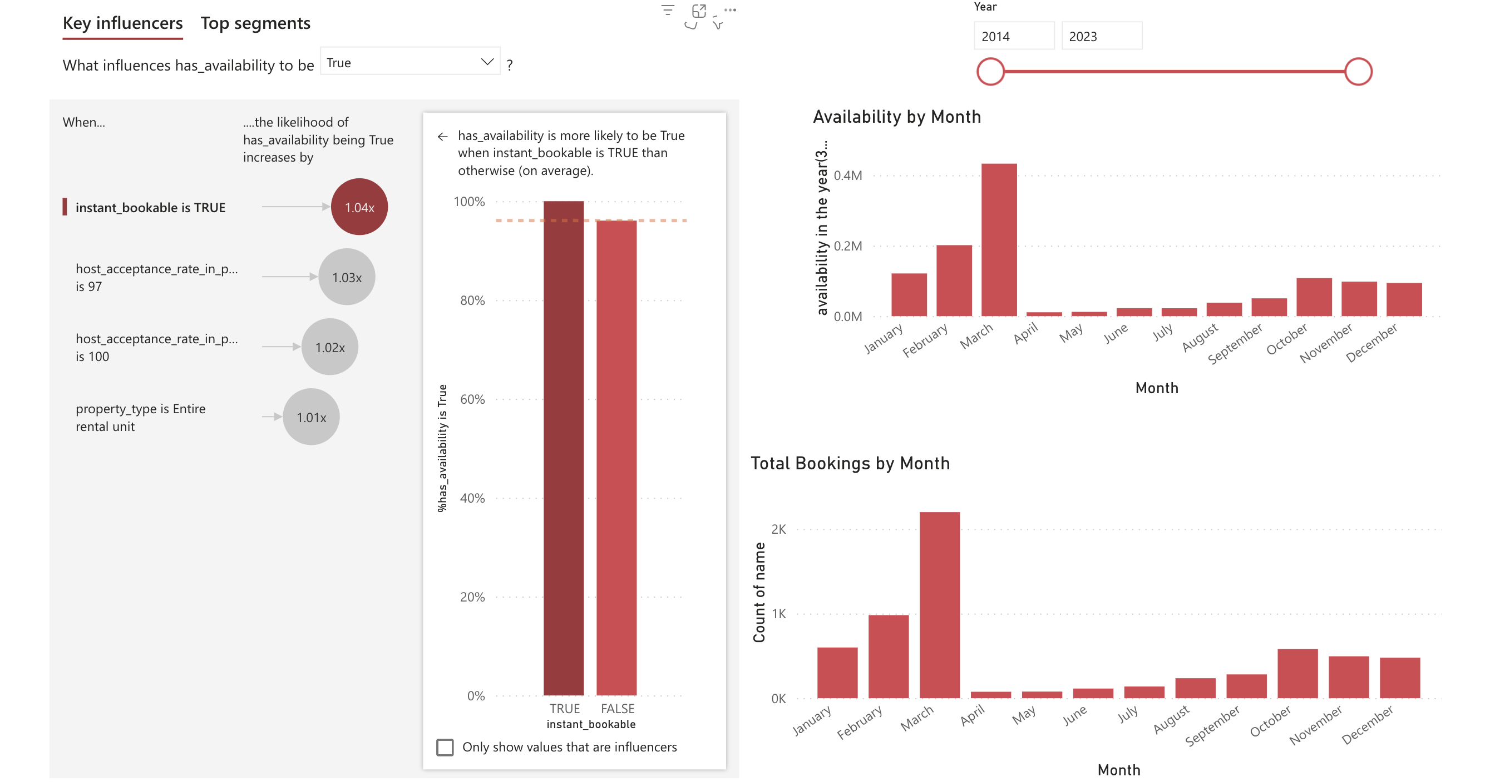
Availability Analysis

Slide 26
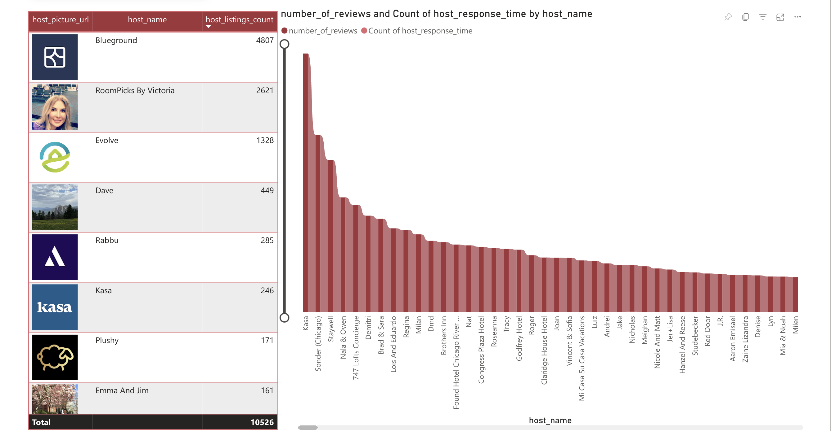
Host Analysis

Slide 27
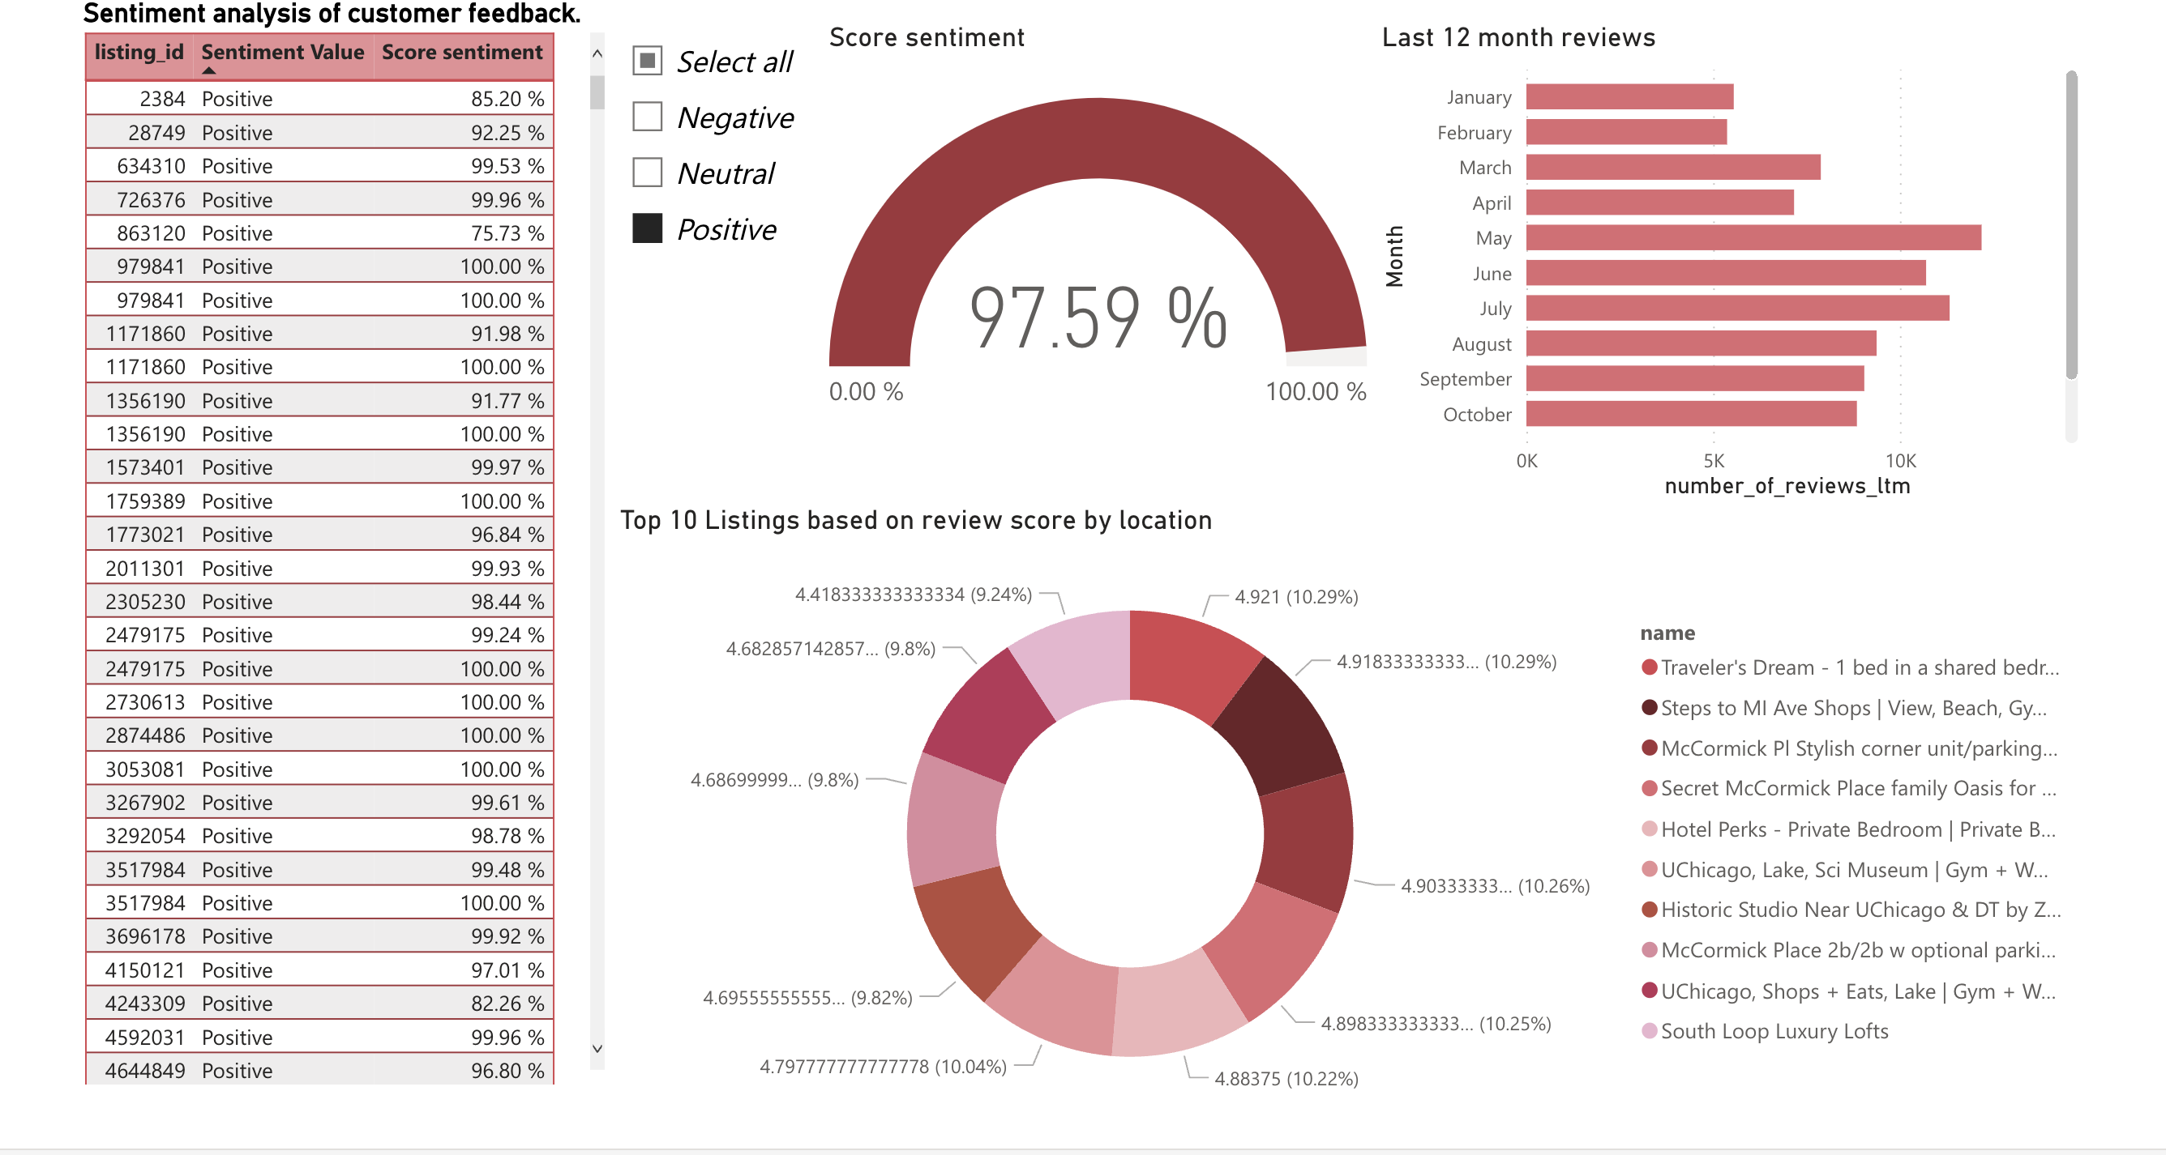
Review Analysis

Slide 28
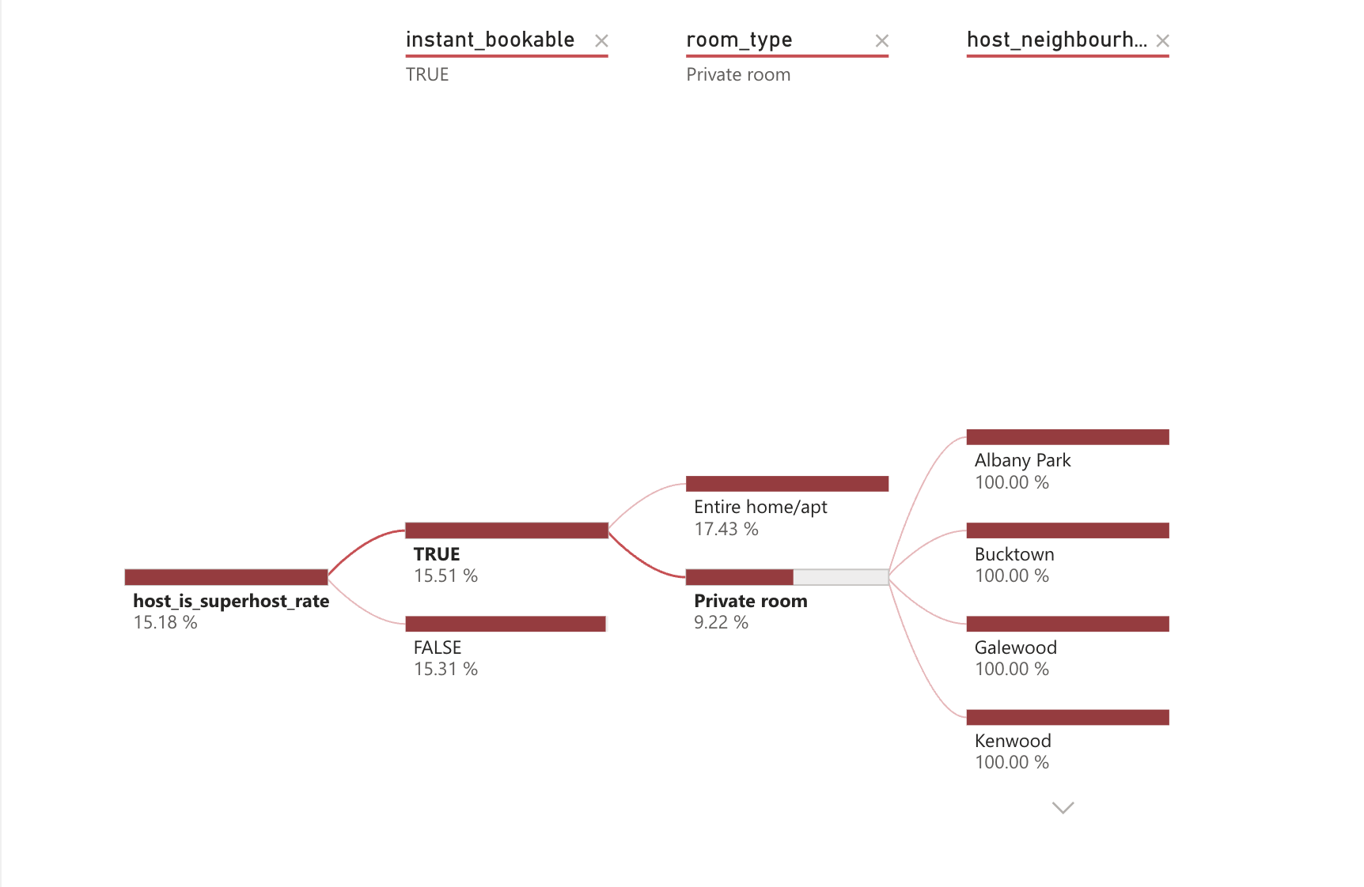
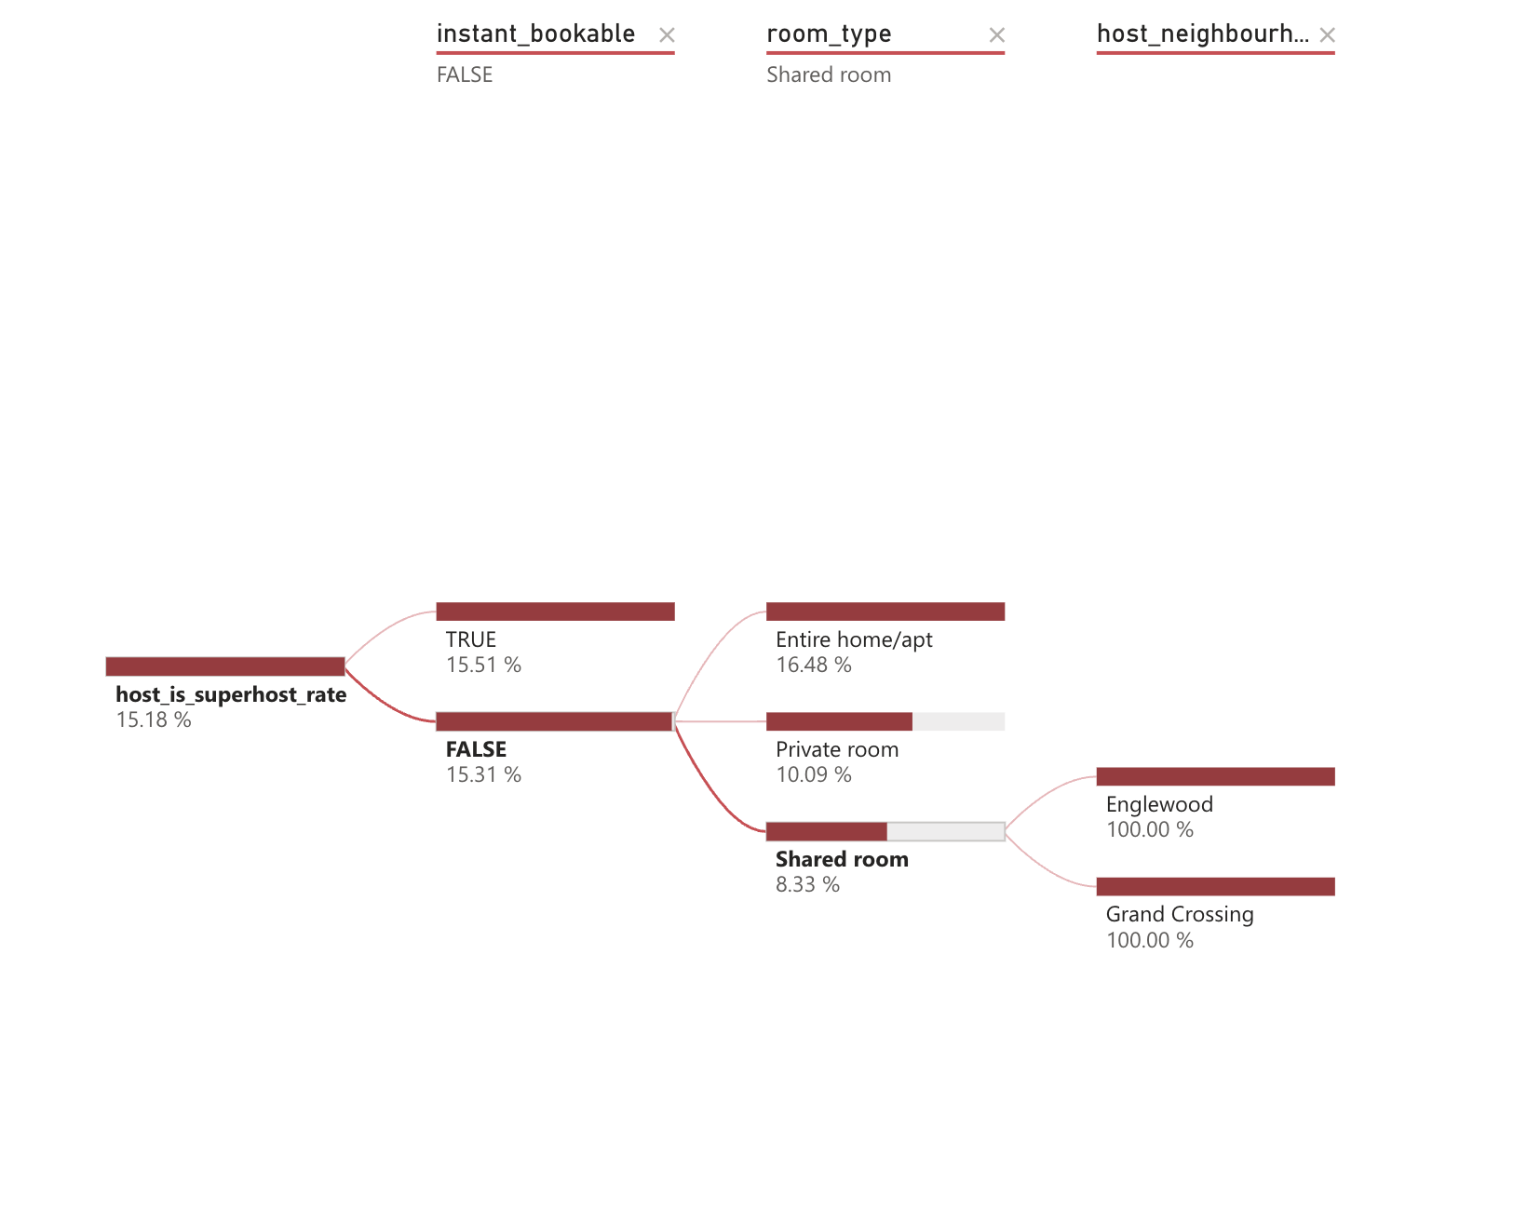
Decomposition Tree

Slide 29
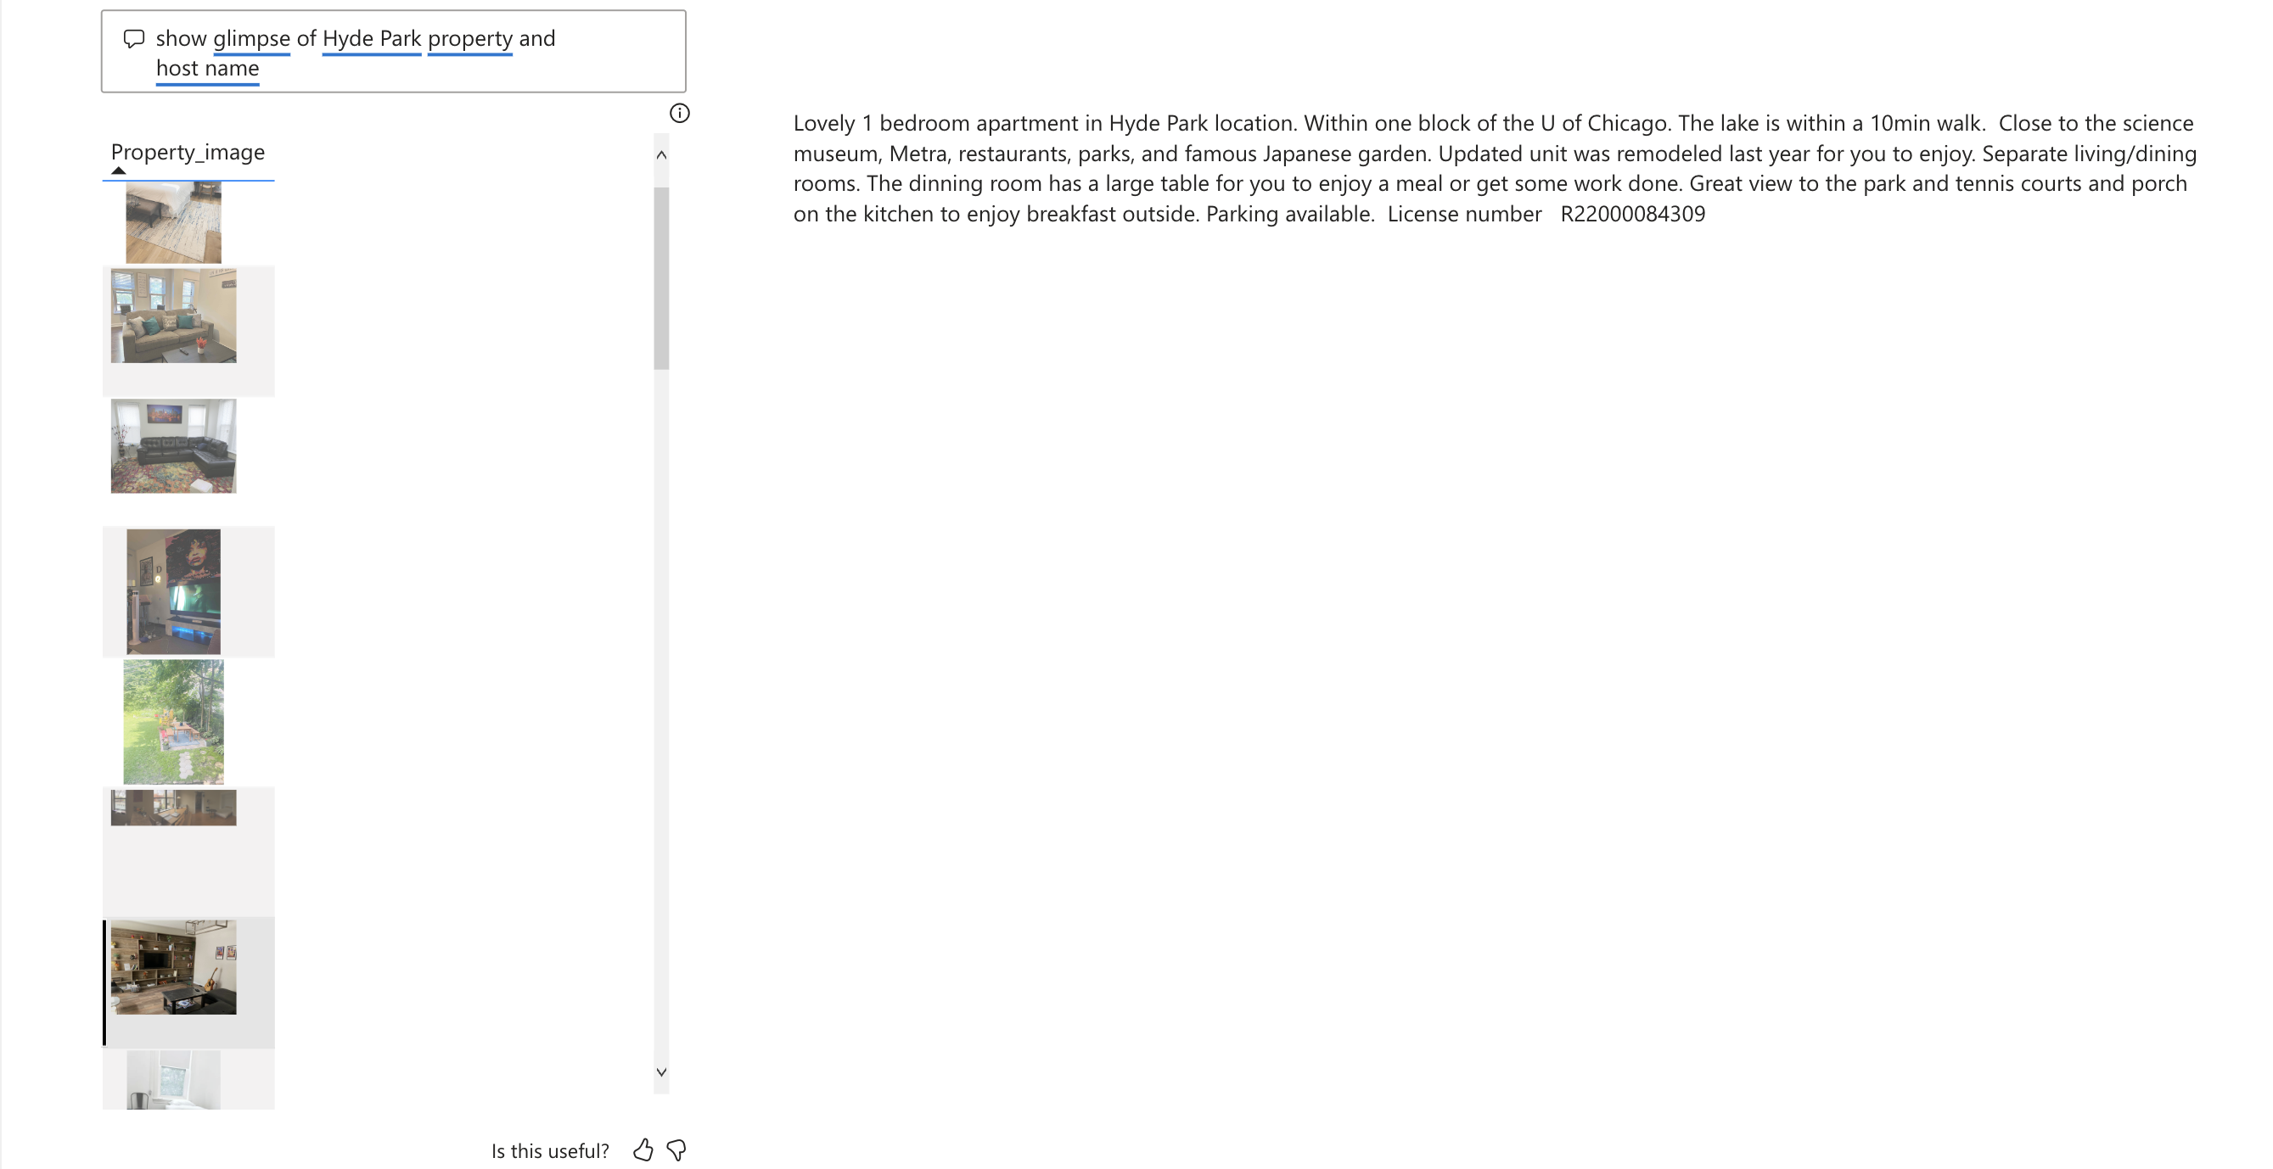
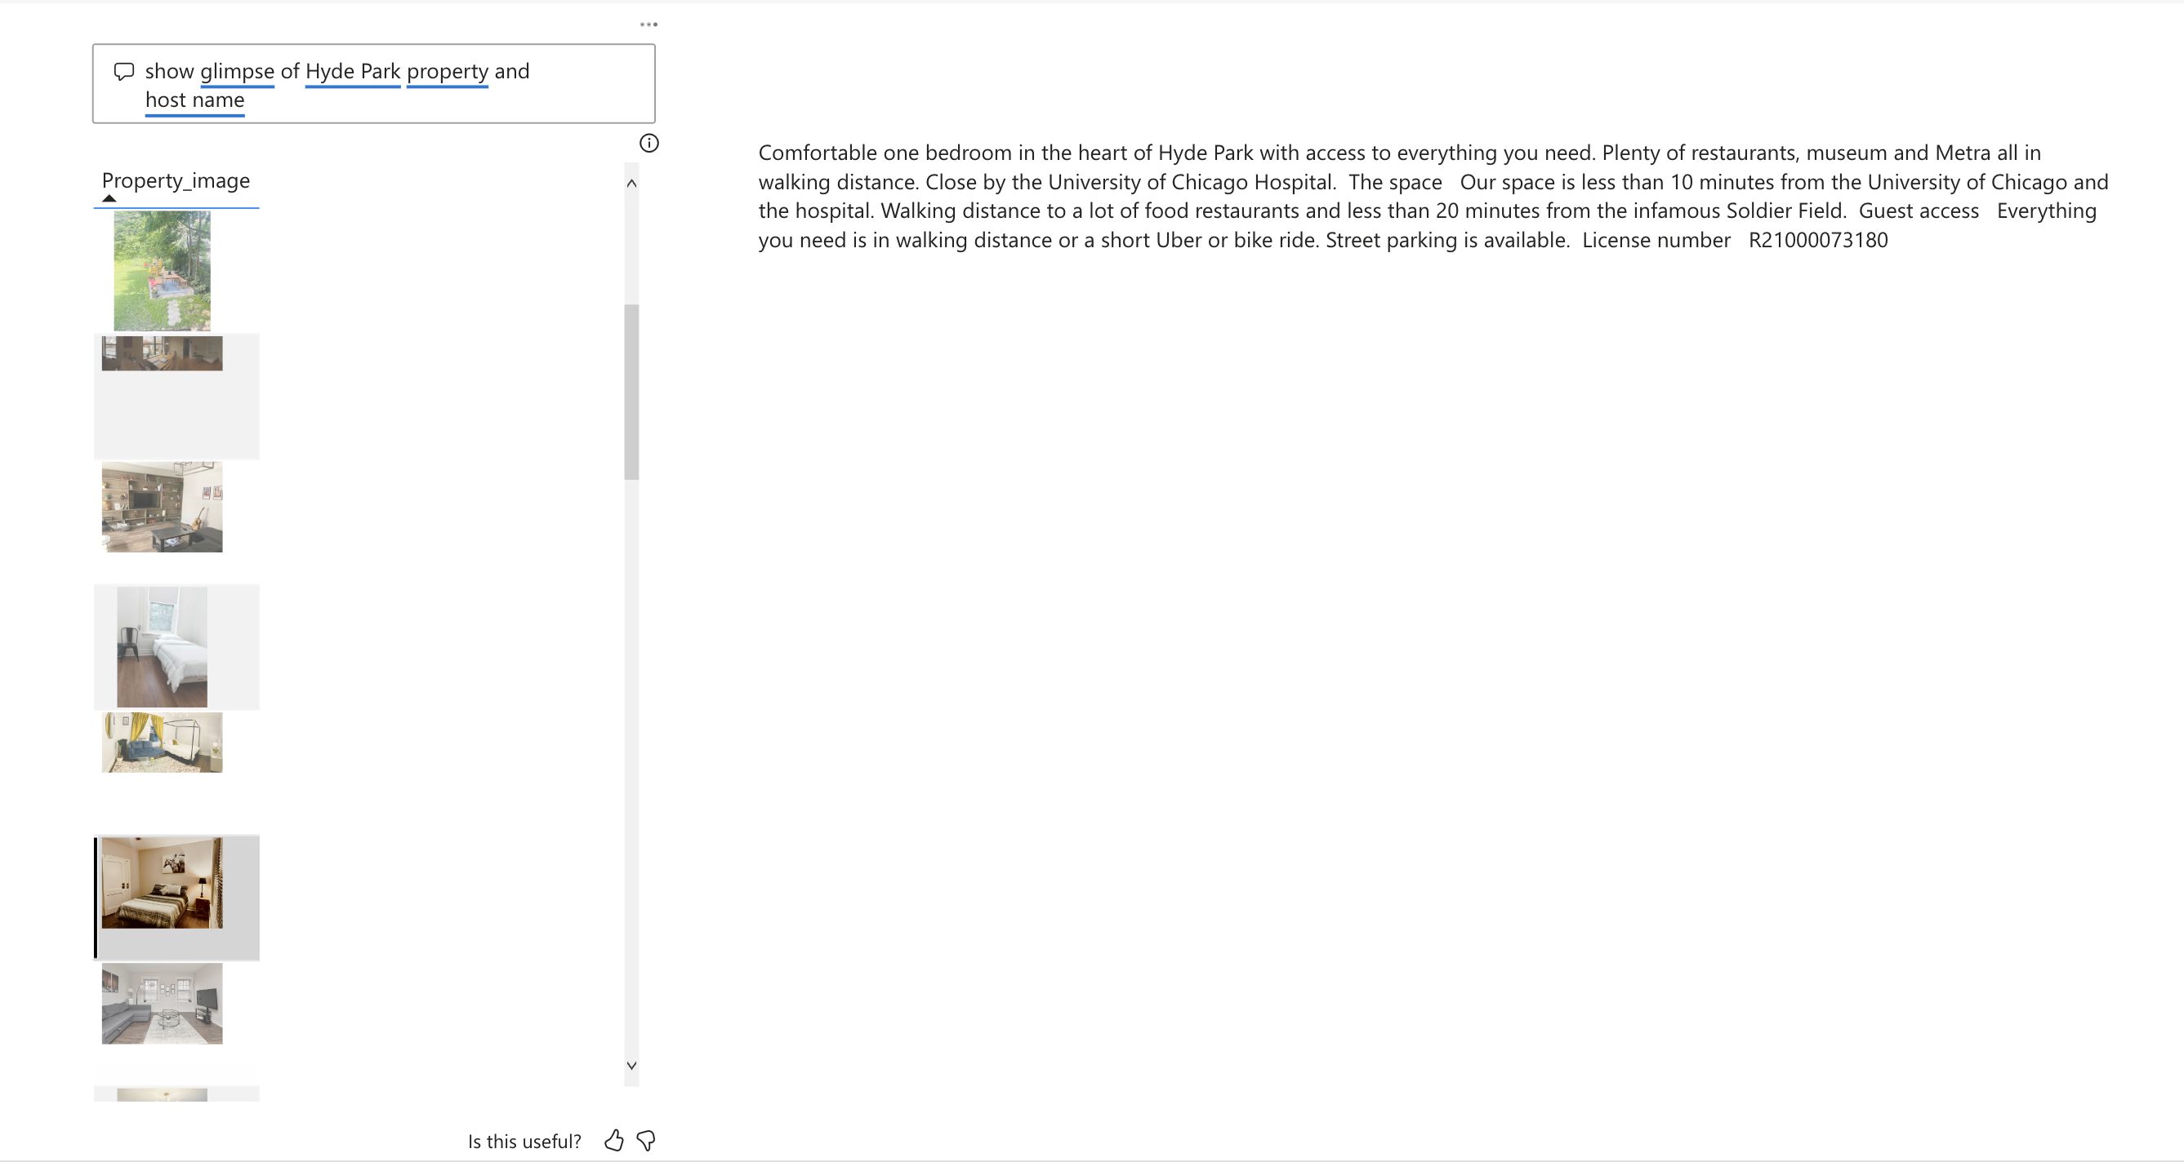
Teach Q&A/smart Narrative

Slide 30
Findings
In chicago, most of the property types are Entire Apartments/house least are unique stays.
Property with 10 Bedrooms are of high price than with11-12 bedrooms
October month has more listings and Entire unit is leading in prices, reviews and listings.
Has_avaliability is more likely to be true when Instantly_bookable is true, host acceptance rate is 97%, 100% and property type is entire rental unit.

Slide 31
Findings
Host Blue ground has highest listings followed by Room picks by victoria
As the host response rate increases the number of reviews increased
97.59% of reviews are positive about the chicago listings and traveler's dream is the top listing as per location review score

Slide 32
Conclusion
As per our analysis on the listings of the Chicago
If the host response rate is good then the reviews are positive.
People are looking for properties with instantly bookable properties

